Slide 1
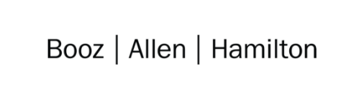

Cloud Excellence Presentation
Team 2
Members: Michael Chusuei, Bob Paolino, Heber Zambrano,
Quane’ Washington, Jared Dahlberg

Slide 2
TEAM 2:
Static Website Deployment using S3
Our Official Project for the Booz Allen Cloud Excellence Program
www.webagesolutions.com|1.877.517.6540

Slide 3
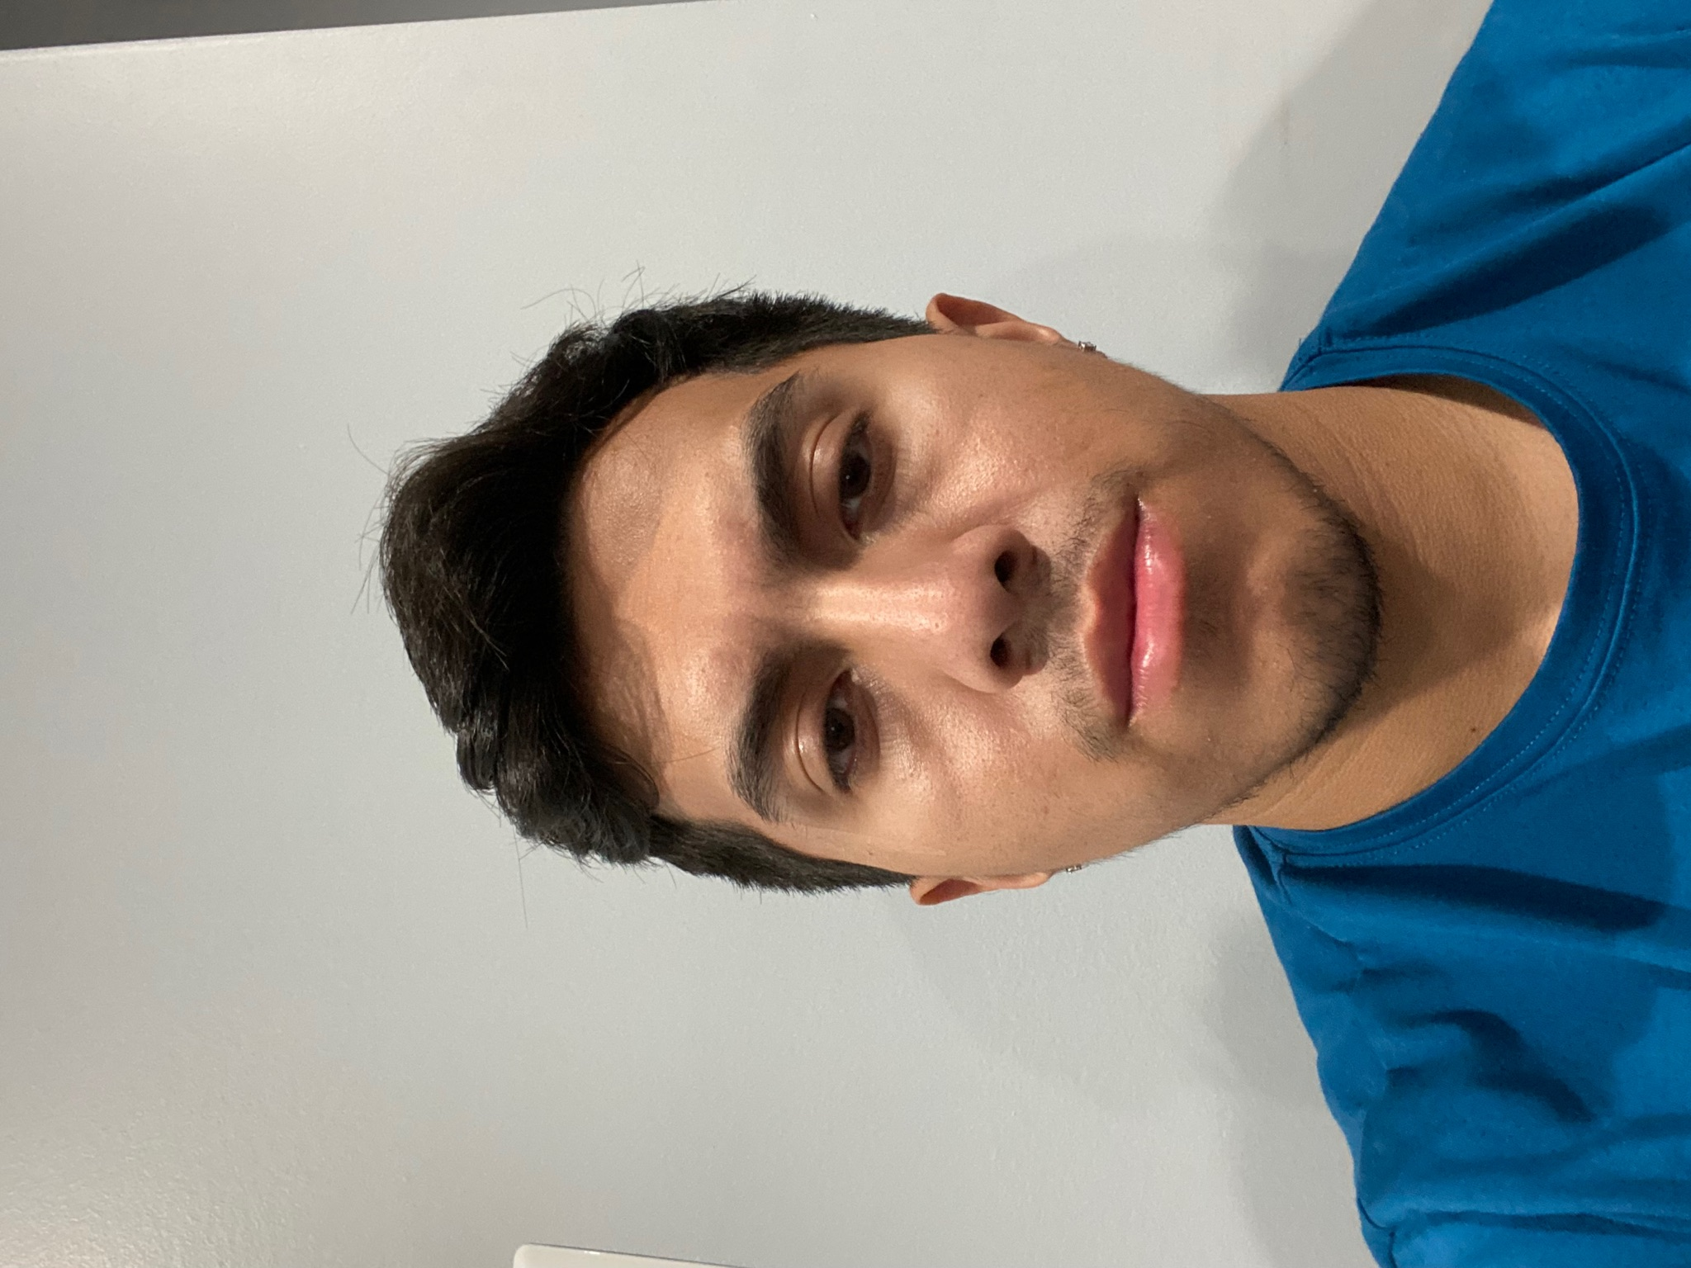
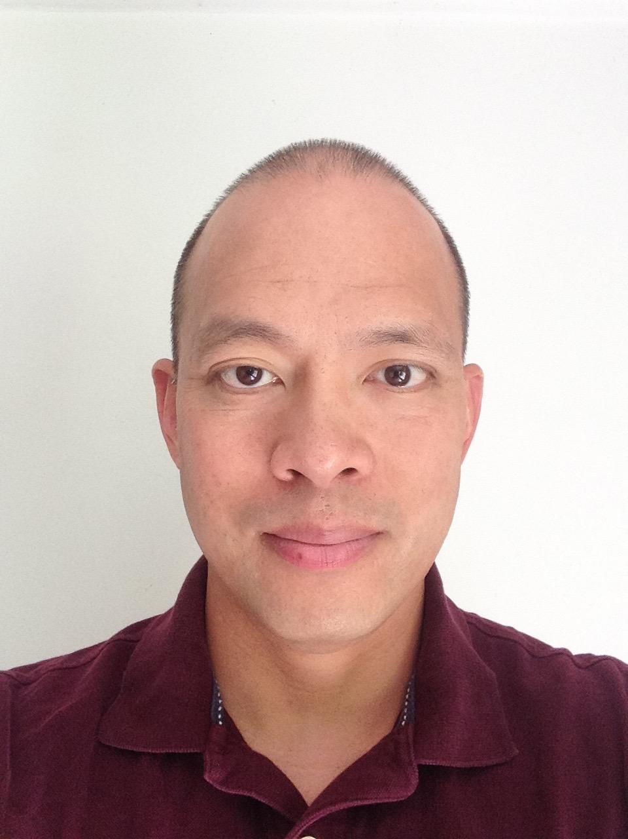
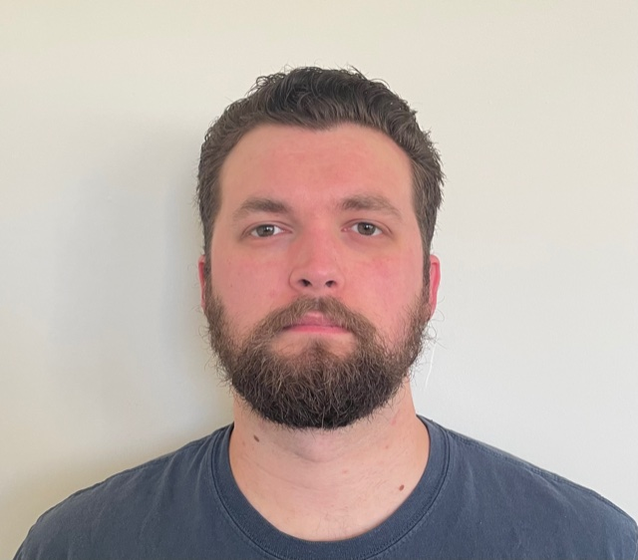

INTRODUCTIONS
MICHAEL CHUSUEI Cloud Engineer
Booz Allen Hamilton
BOB PAOLINO Cloud Engineer
Booz Allen Hamilton
HEBER ZAMBRANO Cloud Engineer
Booz Allen Hamilton
QUANE’ WASHINGTON Cloud Engineer
Booz Allen Hamilton
JARED DAHLBERG Cloud Engineer
Booz Allen Hamilton

Slide 4
Project
Introductions
Project Overview
Architecture and Design
Tools and Technologies Used
Challenges and Issues
What We Have Learned
Demo
What We Would Add
Questions
Deploying a Static Website to AWS Using S3 and CloudFront
www.webagesolutions.com|1.877.517.6540

Slide 5
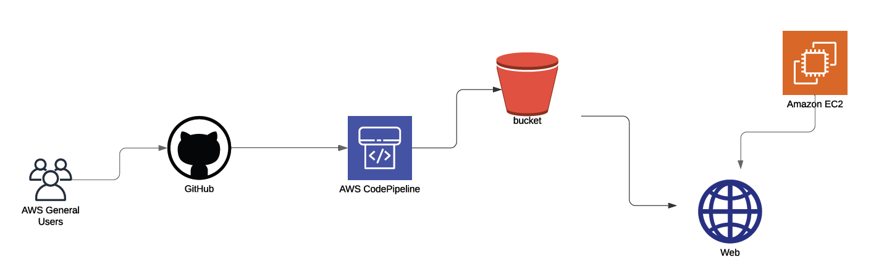
Architecture and Design - Version 1

Slide 6
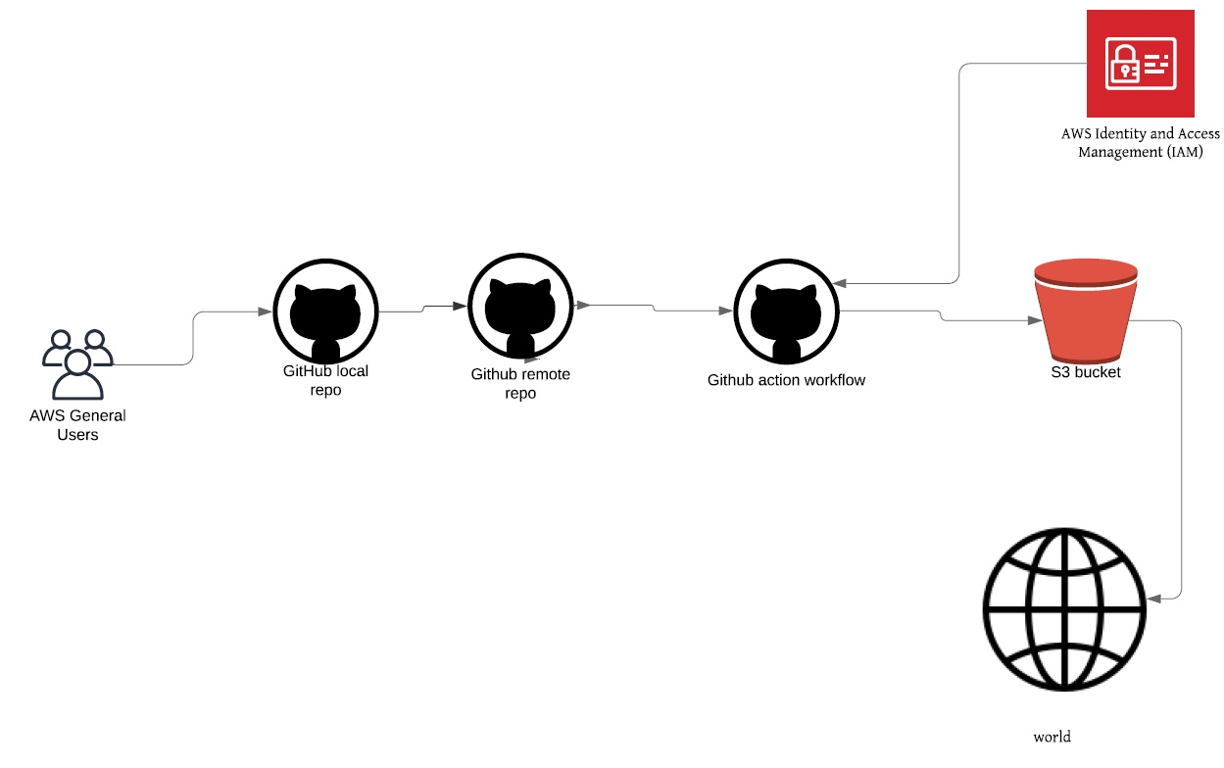
Architecture and Design - Version 2

Slide 7
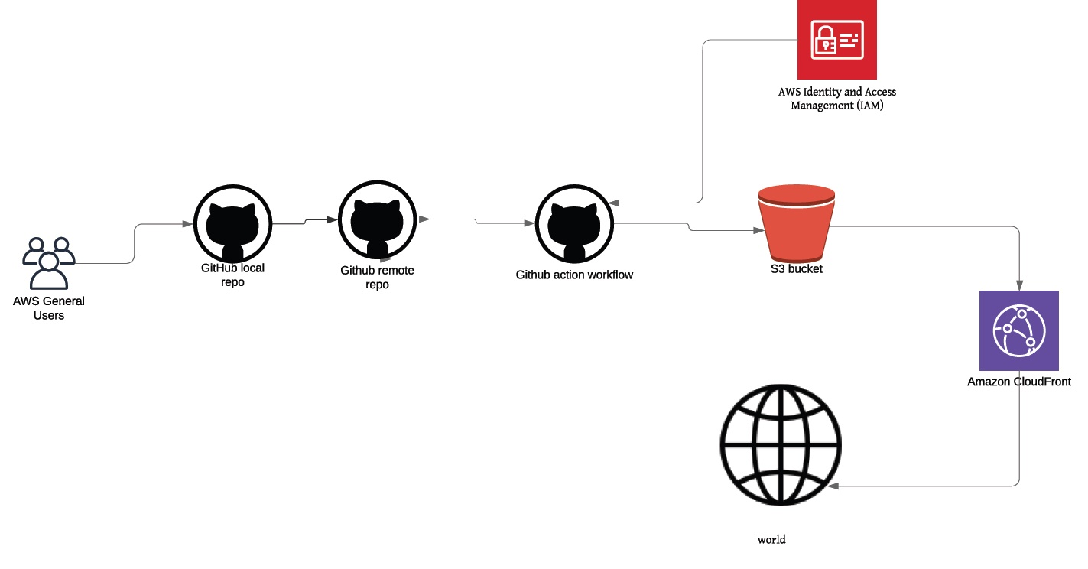
Architecture and Design - Version 3

Slide 8
Tools and Technologies Used
AWS S3
AWS CodePipeline
AWS IAM
AWS CloudFront
GitHub
Visual Code Studio
Former2
Final Product
AWS S3
AWS IAM
AWS CloudFront
GitHub
Former2

Slide 9
Challenges, Issues and Changes
Challenges and Issues
Creating YAML script is hard
Lots of troubleshooting when adding/changing services
Issues with getting S3 to read our GitHub repository
Changes
Moved to
Lots of troubleshooting when adding/changing services
Issues with getting S3 to read our GitHub repository

Slide 10
What We Have Learned

Slide 11
Demo

Slide 12
Future State - What we would add
Load balancers
VPCs
Metrics
Route 53 – creating a real domain name
CloudWatch

Slide 13
Questions?

Slide 14
Fin
Thank you!

